Slide 1
POSIX SHELL
Team: Pointers

Slide 2
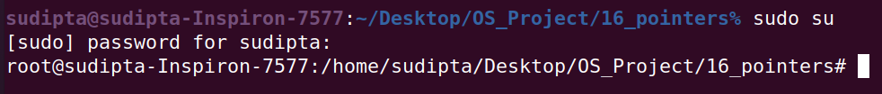
Prompt
Prompt in the form of USER + "@" + HOST + ":" + "~" + DIR + user_symbol

Slide 3
HOME, USER, HOSTNAME
echo $HOME
echo $USER
echo $HOSTNAME

Slide 4
Auto Complete
On writing any partial command if we enter the tab key, it’ll show the possible proposed autocompletions.

Slide 5
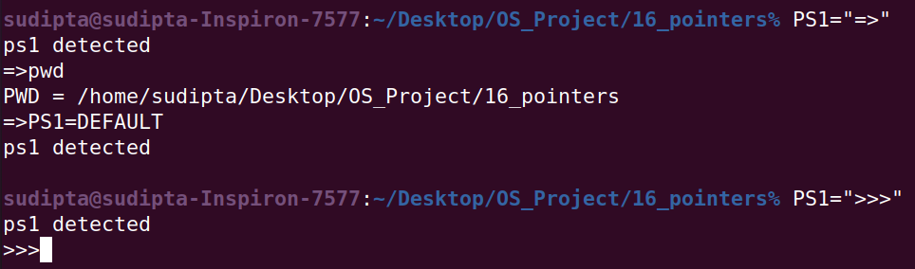
Look for prompt via PS1
On writing PS1=”<symbol>”, the prompt will change to <symbol>.
On writing PS1=DEFAULT, the prompt will go back to normal.

Slide 6
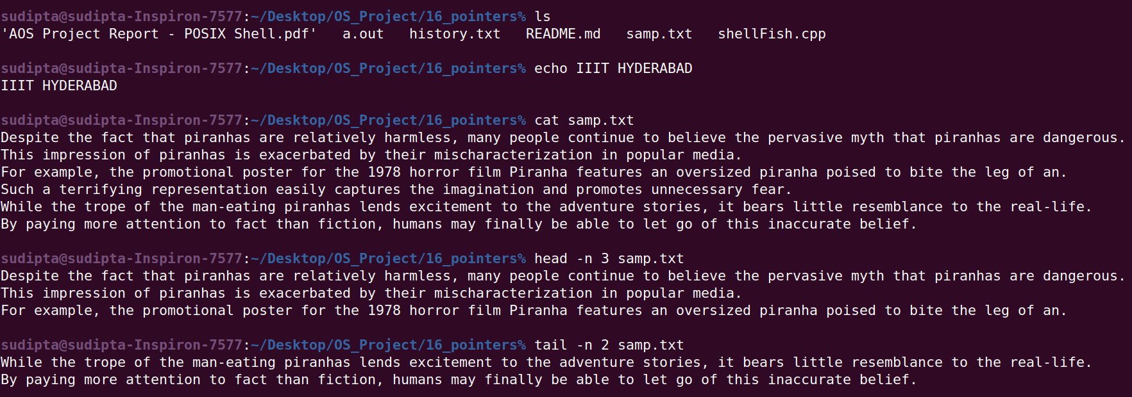
Commands
ls, echo, cat, head, tail has been implemented.

Slide 7
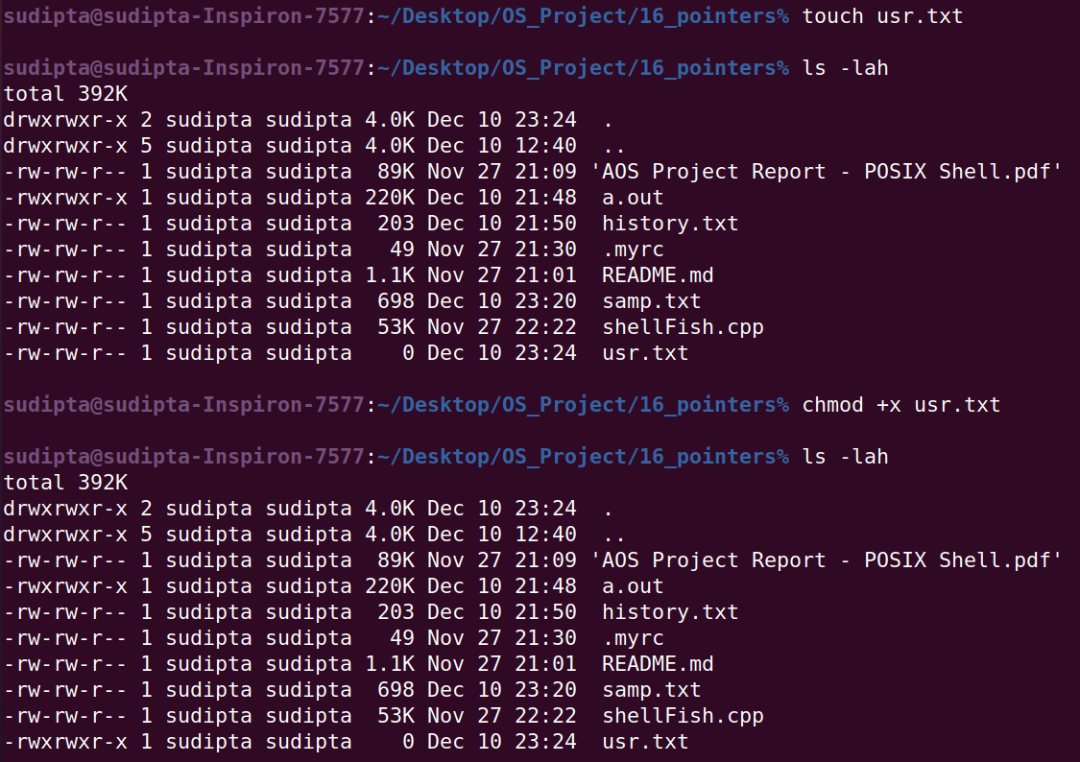
Commands
touch, chmod

Slide 8
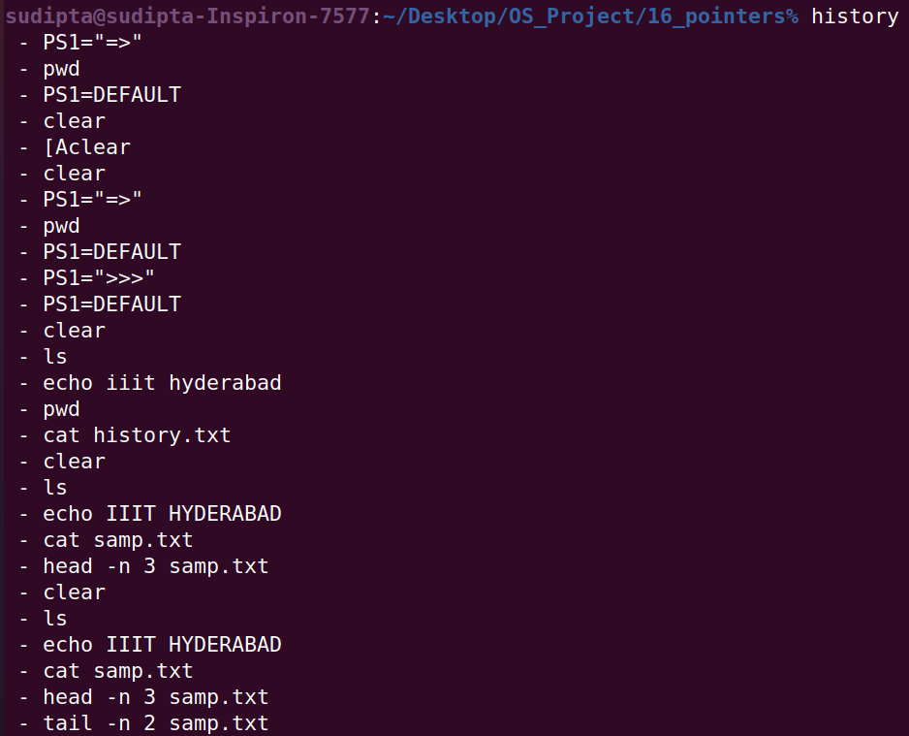
Commands
history

Slide 9
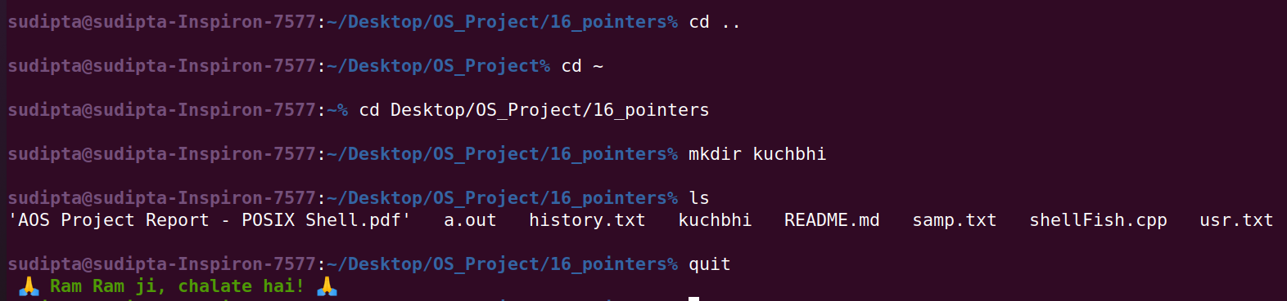
Commands
cd, mkdir, quit

Slide 10
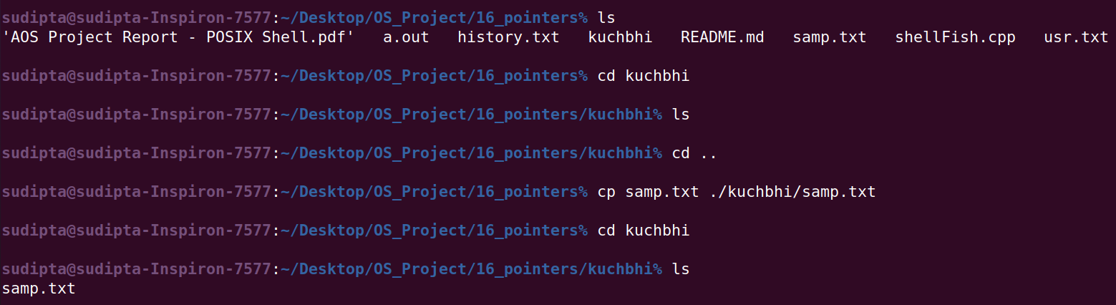
Command
cp

Slide 11
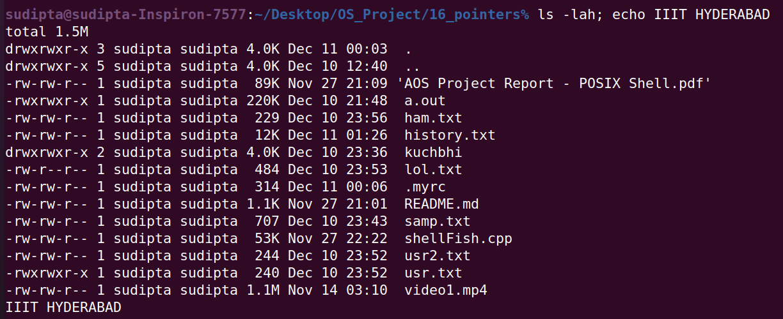
Command
Running multiple commands separated by ‘;’

Slide 12
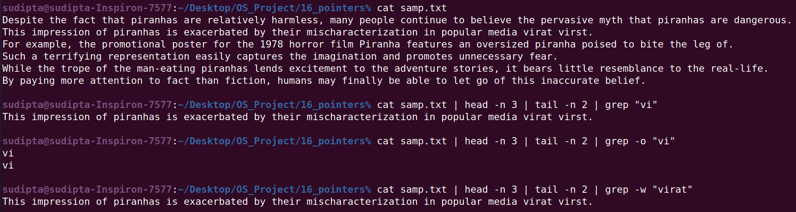
Piping for execution chaining
‘|’ can be used to concatenate any number of commands.

Slide 13
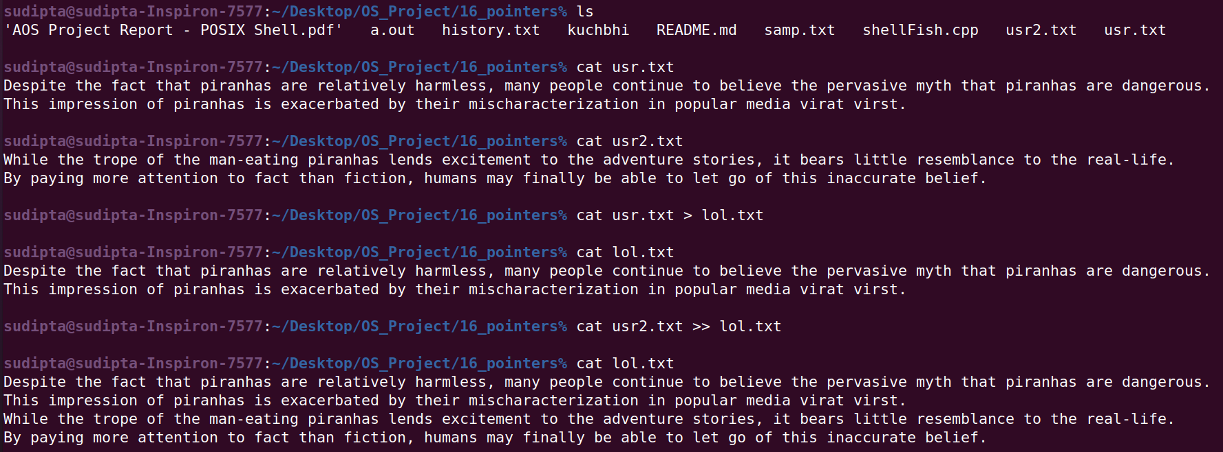
I/O Redirection
IO redirection with ‘>>’(append) and ‘>’(write) is done for one source and one destination.

Slide 14
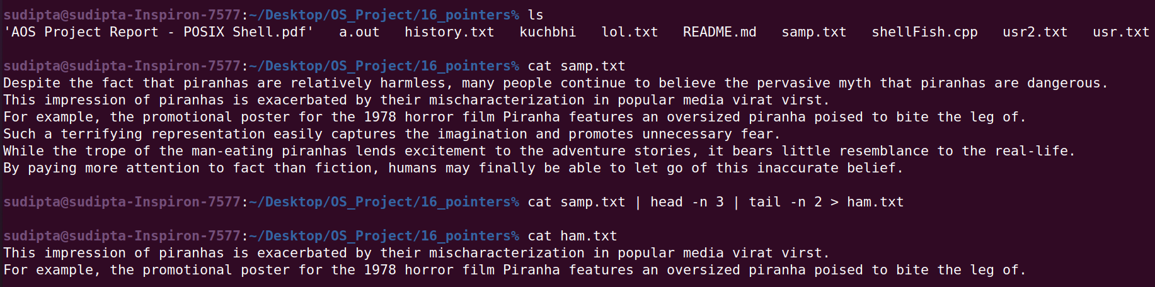
Piping with I/O Redirection
Piping can be used with I/O redirection also.

Slide 15
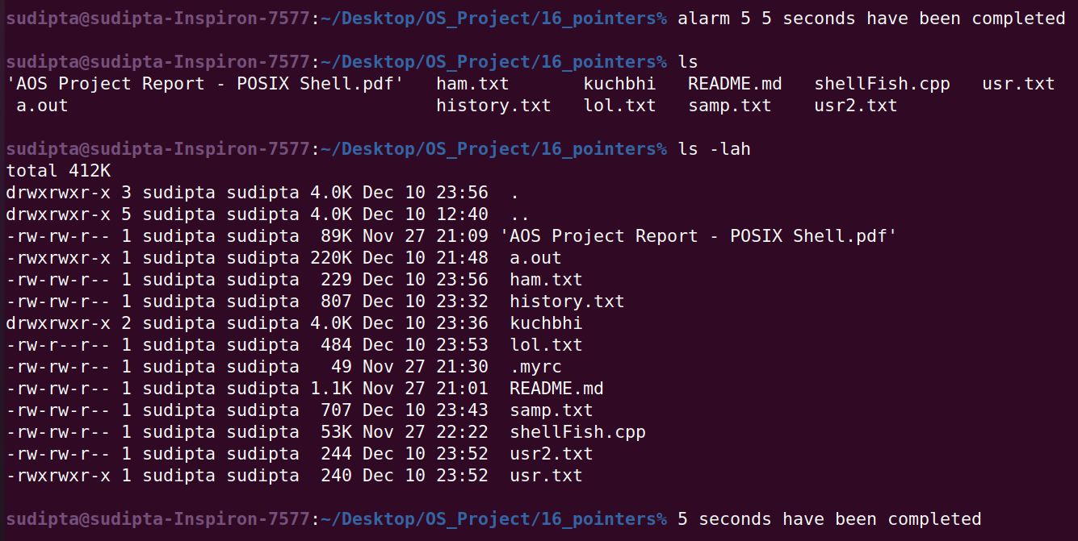
Alarm
A reminder / alarm (text based) has been implemented.

Slide 16
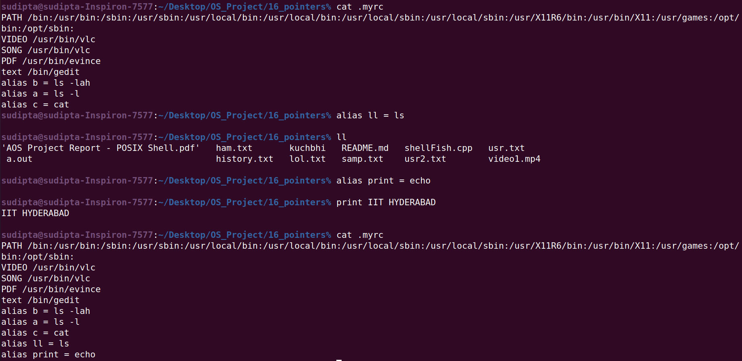
Alias
Implemented alias support for commands

Slide 17
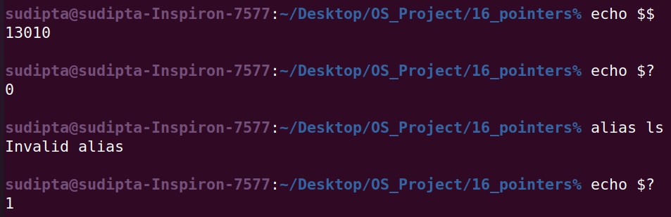
Support for ‘$$’ ‘$?’
$$ is the id of the current process.
The $? variable represents the exit status of the previous command.

Slide 18
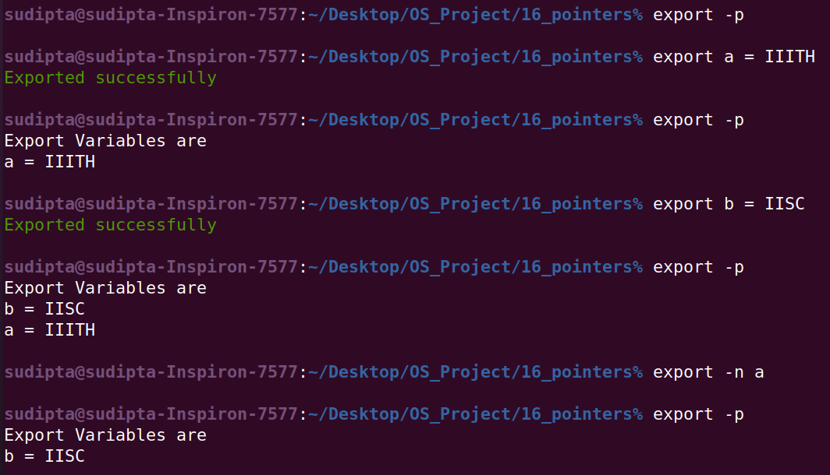
Environment variables and export.
Export variables support .

Slide 19
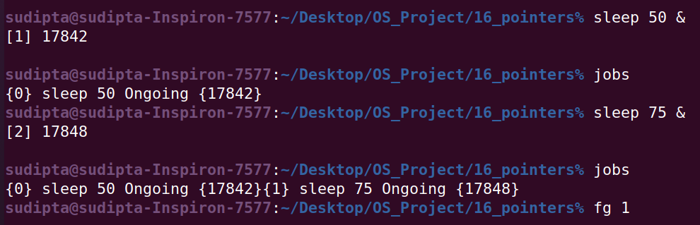
Background and Foreground Process
Push a command in background by passing ‘&’ as last token.
We are maintaining a list of background jobs.
We can bring any background job to foreground by ‘fg <job_num>’

Slide 20
Questions?

Slide 21
Thank You

